Slide 1

KDIGO 2021 Clinical Practice Guideline for the Management of Blood Pressure in CKD
KDIGO Guideline Co-Chairs:
Alfred K. Cheung, MD
Johannes F.E. Mann, MD
Guideline: Kidney Disease: Improving Global Outcomes (KDIGO) Blood Pressure Work Group. KDIGO 2021 Clinical Practice Guideline for the Management of Blood Pressure in Chronic Kidney Disease. Kidney Int. 2021;99(3S):S1–S87
Executive Summary: Cheung AK. Chang TI, Cushman WC, et al. Executive summary of the KDIGO 2021 Clinical Practice Guideline for the Management of Blood Pressure in Chronic Kidney Disease. Kidney Int. 2021; 99(3): 559–569

Slide 2
Table of contents
Introduction
Guideline development process:
Evidence review
Guideline format
Guideline statements and rationale from:
Chapter 1. Blood pressure measurement
Chapter 2. Lifestyle interventions for lowering blood pressure in patients with CKD not receiving dialysis
Chapter 3. Blood pressure management in patients with CKD, with and without diabetes, not receiving dialysis
Chapter 4. Blood pressure management in kidney transplant recipients (CKD G1T-G5T)
Chapter 5. Blood pressure management in children with CKD
Question and answer

Slide 3
KDIGO Programs
Guidelines
KDIGO’s core mission. KDIGO is the only organization developing global guidelines in nephrology.
Controversies Conferences
International Conferences that examine significant topics in nephrology and related disciplines that are not fully resolved. Results in a published paper, usually in Kidney International. Often a Controversies Conference will prompt development of a guideline or a guideline update.
Implementation Activities
Dissemination and Implementation of KDIGO Guidelines
Controversies Conference Reports and Observations
Live Clinical Practice Conferences – usually with a nephrology society to bring global KDIGO’s work to local audiences, using case studies
Implementation Summits bring local experts together to discuss local or regional barriers and opportunities
Core Implementation Kits – educational materials including Speaker’s Guides, Reference Tools, and Case Studies to assist with implementation of all KDIGO publications

Slide 4
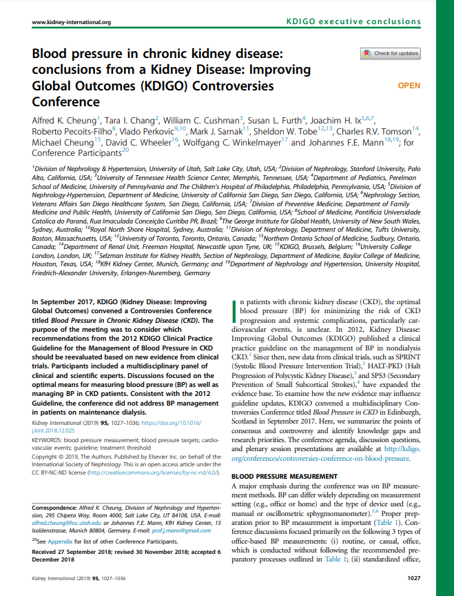
KDIGO Controversies Conference on BP in CKD
September 2017 (Edinburgh, Scotland)
Topics:
BP Measurement
Management of Hypertension in CKD Patients with Diabetes vs. without Diabetes
Management of Hypertension in CKD among Elderly and Individuals with Previous Stroke
Management of Hypertension in CKD in Transplant and Pediatric Populations
Report published in Kidney International (2019)
Led to initiation of an update of the KDIGO BP clinical practice guideline

Slide 5
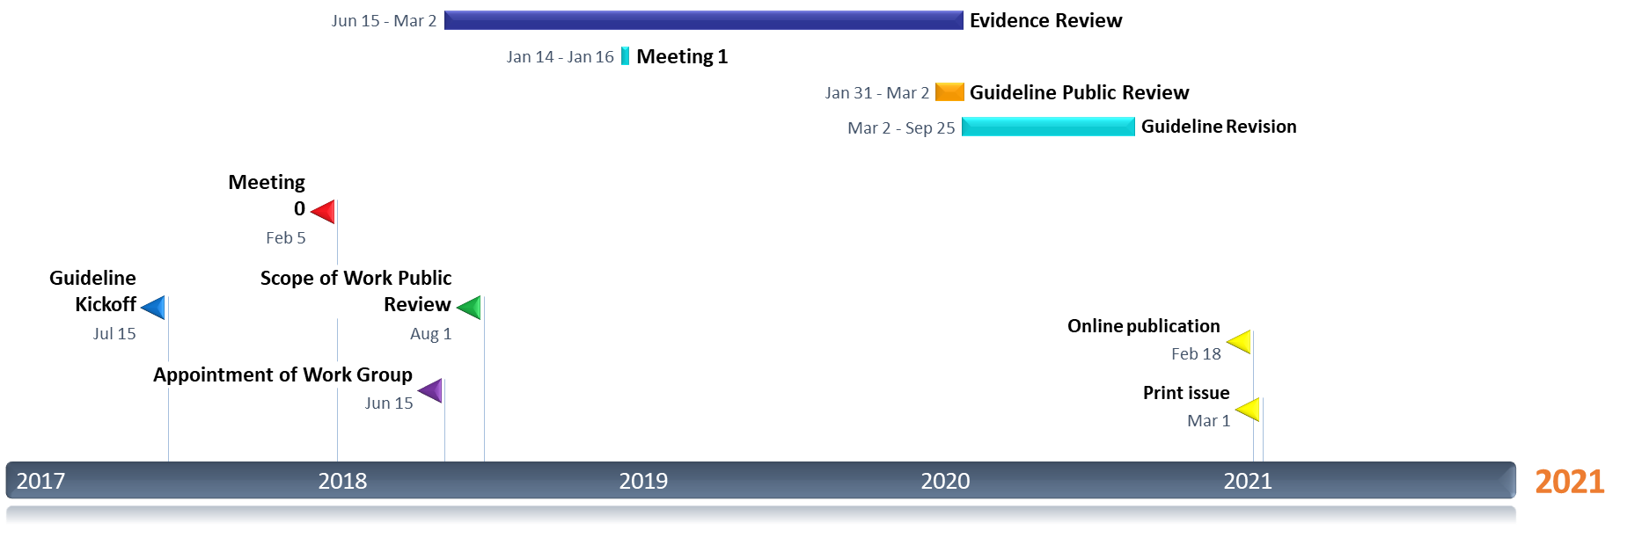
Timeline of Guideline for BP Management in CKD

Slide 6
KDIGO 2012 Guideline: The Beginning

Slide 7
Scope of the Clinical Practice Guideline
Include:
Patients, adults and children, with CKD not receiving dialysis
All CKD not receiving dialysis
Kidney transplant recipients
BP measurement techniques
Interventions addressed with rigorous data (RCTs)
Lifestyle
Targets
Pharmacotherapy
Exclude:
Dialysis patients
Interventions covered elsewhere
For example, lipids and BP in patients receiving dialysis
Topics with insufficient data on the risks or benefits on BP in CKD
Weight loss
Reduction in alcohol consumption
Emerging & pipeline therapies

Slide 8
Guideline Goals
Generate a useful resource for clinicians and patients
Address relevant questions with actionable recommendations
Take on controversial topics when sufficient evidence
Communicate clearly
Stay true to evidence
Target audience: Primarily clinicians treating CKD patients, kidney transplant recipients, and children with high blood pressure
Be mindful of implications for policy and payment
Propose research questions

Slide 9
Work Group
Worldwide scope
Prior GL WG Members
Deep experience
Evidence Review Team

Slide 10

Work Group
Missing from photo: Susan Furth, Sheldon Tobe

Slide 11
What Is New Since the 2012 KIDGO Guideline
More work and emphasis on techniques of BP Measurement
SPRINT (Systolic Blood Pressure Intervention Trial) and SPRINT-MIND
Joint analysis of SPRINT and ACCORD; more subgroup analyses of ACCORD
Large meta-analysis in CKD or non-CKD population

Slide 12

Evidence Review
ERT - Cochrane Kidney Transplant
Existing PICO questions and new PICO questions developed
Clinical and important outcomes identified
Critical outcomes | Important outcomes
All-cause mortality | Doubling serum creatinine
Cardiovascular mortality | Acute kidney injury
Kidney failure (ESKD) | Falls
Cardiovascular events - myocardial infarction, stroke, heart failure | Fatigue
Dementia or cognitive impairment | Body weight/Body mass index (BMI)
 | Blood pressure

Slide 13
PICO Questions
Focus on RCTs - mapped to existing Cochrane Systematic reviews
New systematic reviews undertaken as required
Some focused observational studies reviews
General population - Existing systematic reviews
Population | Intervention | Comparator | Outcome
Blood Pressure Measurement
Patients with CKD (CKD G1-G5, including transplant) General population | Oscillometric (office-based) BP (unattended or attended), ambulatory BP, home oscillometric monitors | Auscultatory office-based BP monitoring | Sensitivity, specificity, negative predictive value, positive predictive value; Cost-effectiveness

Slide 14
Population | Intervention | Comparator | Outcome
Lifestyle Interventions
Adults with CKD (CKD G1-G5) with and without diabetes | Low protein diet | Usual protein diet | Critical and important outcomes
Adults with CKD (CKD G1-G5) with and without diabetes (T1D or T2D) | Low salt diet | Usual salt diet | Critical and important outcomes, urinary sodium excretion, SCr, BMI
Adults with CKD | Dietary modifications (including dietary advice or lifestyle management) | Standard of care (including lifestyle advice) or any other dietary pattern | Critical and important outcomes
Adults with CKD (CKD G1-G5) and high BP | Any exercise intervention >8 weeks duration | Standard of care | Critical and important outcomes, fat mass, quality of life

Slide 15
Population | Intervention | Comparator | Outcome
BP Management in Patients with CKD, with and without Diabetes, not Receiving Dialysis
Adults with CKD (CKD G1-G5) with and without diabetes (T1D or T2D) | Low BP target | Standard BP target | Critical and important outcomes
Adults with CKD (CKD G1-G5) with and without diabetes (T1D or T2D) | ACEi, ARB, aldosterone antagonists | Placebo or standard of care | Critical and important outcomes
Adults with CKD (CKD G1-G5) with and without diabetes (T1D or T2D) | Non-RAS inhibitors (alpha blockers, beta-blockers, CCB, DRI, diuretics) | Placebo or RASi | Critical and important outcomes
Adults with CKD (CKD G1-G5) with and without diabetes (T1D or T2D) | Dual RASi | Mono RASi | Critical and important outcomes
Adults with CKD (CKD G1-G5) with chronic hyperkalemia | Potassium binders | Placebo or standard of care | Critical and important outcomes, hospitalization, hypokalemia

Slide 16
Population | Intervention | Comparator | Outcome
BP Management in Kidney Transplant Recipients
Kidney transplant recipients (G1T-G5T) | Low protein diet | Usual protein diet | Critical and important outcomes
Kidney transplant recipients (G1T-G5T) | Low salt diet | Normal salt diet | Critical and important outcomes, sodium excretion, SCr
Kidney transplant recipients (G1T-G5T) | Dietary modification (including dietary advice or lifestyle management) | Standard of care (including lifestyle advice) or any other dietary pattern | Critical and important outcomes
Kidney transplant recipients (G1T-G5T) and high BP | Any exercise intervention >8 weeks duration | Standard of care | Critical and important outcomes, BMI, quality of life

Slide 17
Population | Intervention | Comparator | Outcome
BP Management in Kidney Transplant Recipients
Adults and children kidney transplant recipients (G1T-G5T) | Low BP target | Standard BP target | Critical and important outcomes
Adults and children kidney transplant recipients (G1T-G5T) | RAS inhibitors (ACEi, ARB, aldosterone antagonists) or non-RAS inhibitors (alpha blockers, beta-blockers, CCB, DRI, diuretics) | Placebo or standard of care | Critical and important outcomes
Kidney transplant recipients (G1T-G5T) with chronic hyperkalemia | Potassium binders | Placebo or standard of care | Critical and important outcomes, hospitalization, hypokalemia

Slide 18
Population | Intervention | Comparator | Outcome
BP Management in Children with CKD
Children with CKD (CKD G1-G5) | Low BP target | Standard BP target | Critical and important outcomes
Children with CKD (CKD G1-G5) | RAS inhibitors (ACEi, ARB, aldosterone antagonists) or non-RAS inhibitors (alpha blockers, beta-blockers, CCB, DRI, diuretics) | Placebo or standard of care | Critical and important outcomes, SCr

Slide 19
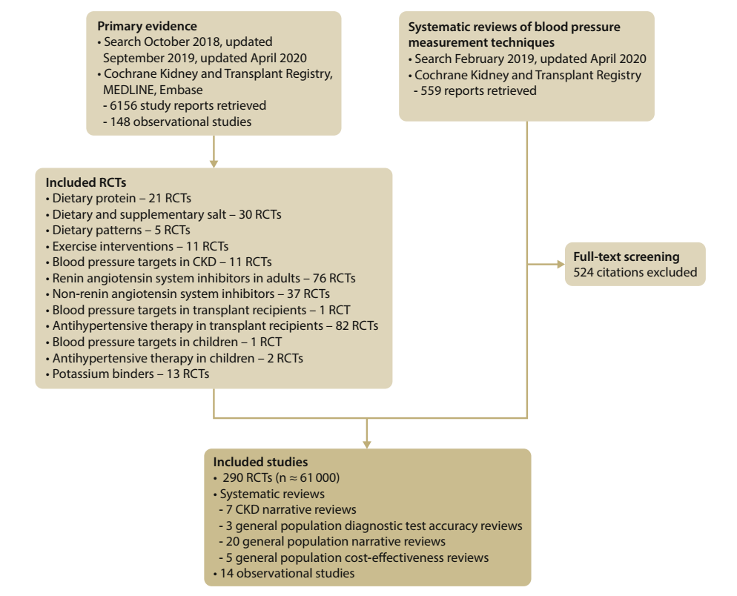
Literature Search October 2018; February 2019, and Final Update in April 2020

Slide 20
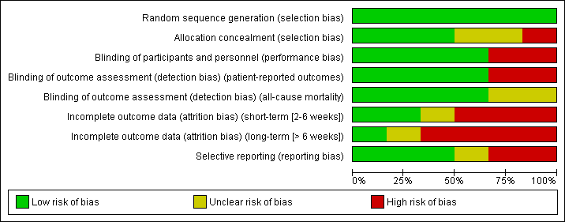
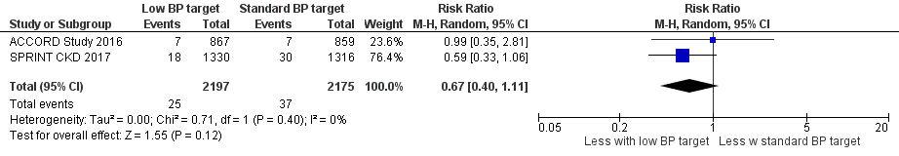
Evidence Synthesis
Risk of bias graph example
Standard Cochrane methods – Two independent reviewers
Data abstraction
Critical appraisal – using validated tools
Data-analysis
Random effects meta-analysis and generic inverse variance
Relative risk for dichotomous outcomes
Mean difference for continuous outcomes
Heterogeneity assessed using the I² statistic
Forest plot example – BP target – CV Mortality

Slide 21

Grading Recommendations
GRADE methodology
The quality of the evidence – Level A, B, C, D
Study limitations
Inconsistency
Indirectness
Imprecision
Publication bias
Strength of the recommendation – Level 1, “We recommend” or Level 2, “We suggest”
One face-to-face meeting – New Orleans Jan 2019
Balance of benefits and harms
Quality of the evidence
Patient values and preferences
Resources and other considerations

Slide 22
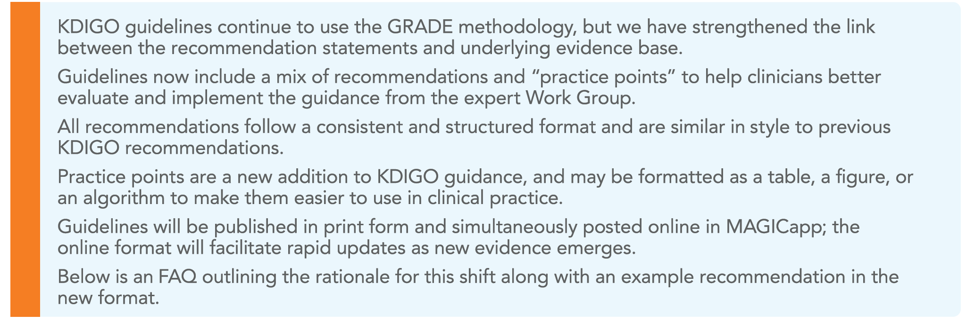
Guideline Format

Slide 23
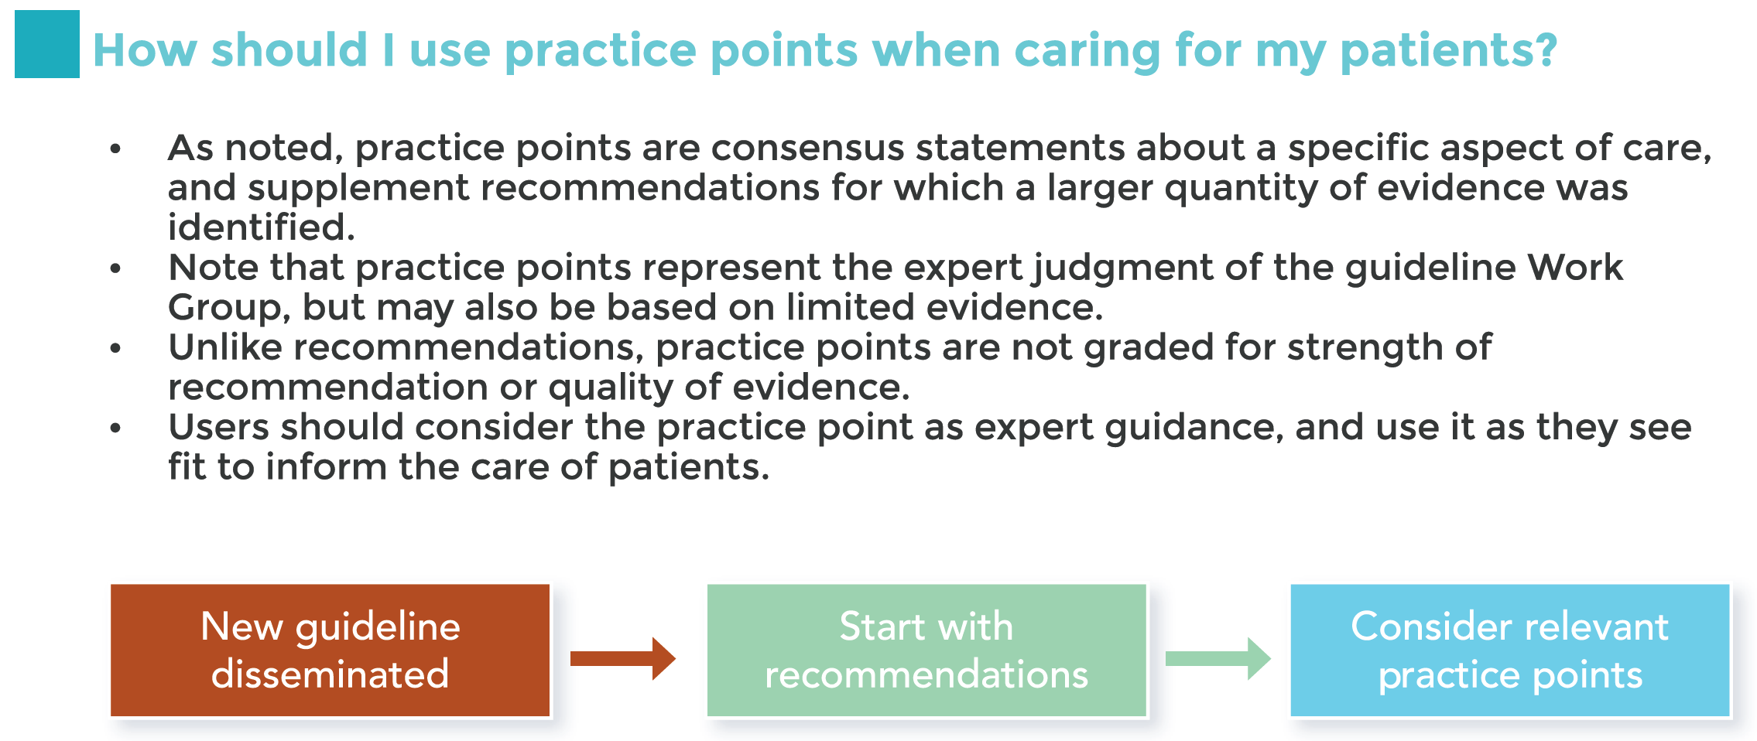
Guideline Format

Slide 24

MAGICapp (Making GRADE the Irresistible Choice)
Electronic guideline publishing software
KDIGO is piloting this online platform to:
directly link evidence to recommendations
increase transparency of guideline process
improve accessibility of guidelines through digital publishing
create “living guidelines” that ease update process
allow generation of patient decision aids
www.magicevidence.org; www.magicapp.org

Slide 25
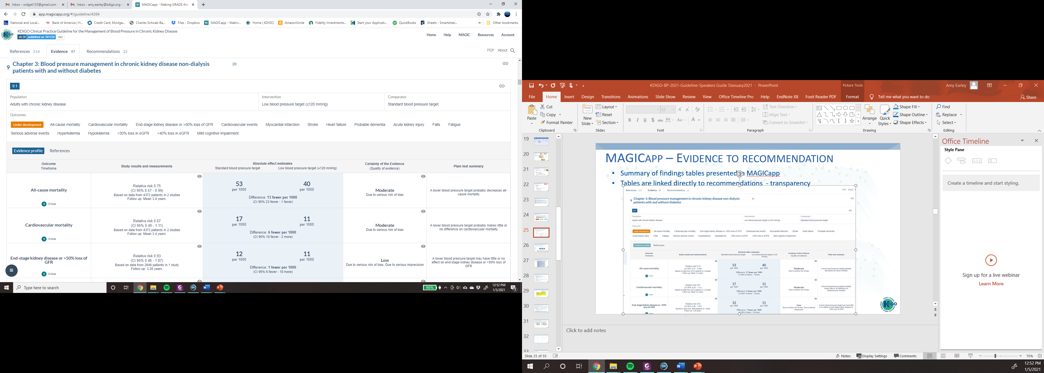
MAGICapp – Evidence to Recommendation
Summary of findings tables presented in MAGICapp
Tables are linked directly to recommendations - transparency

Slide 26
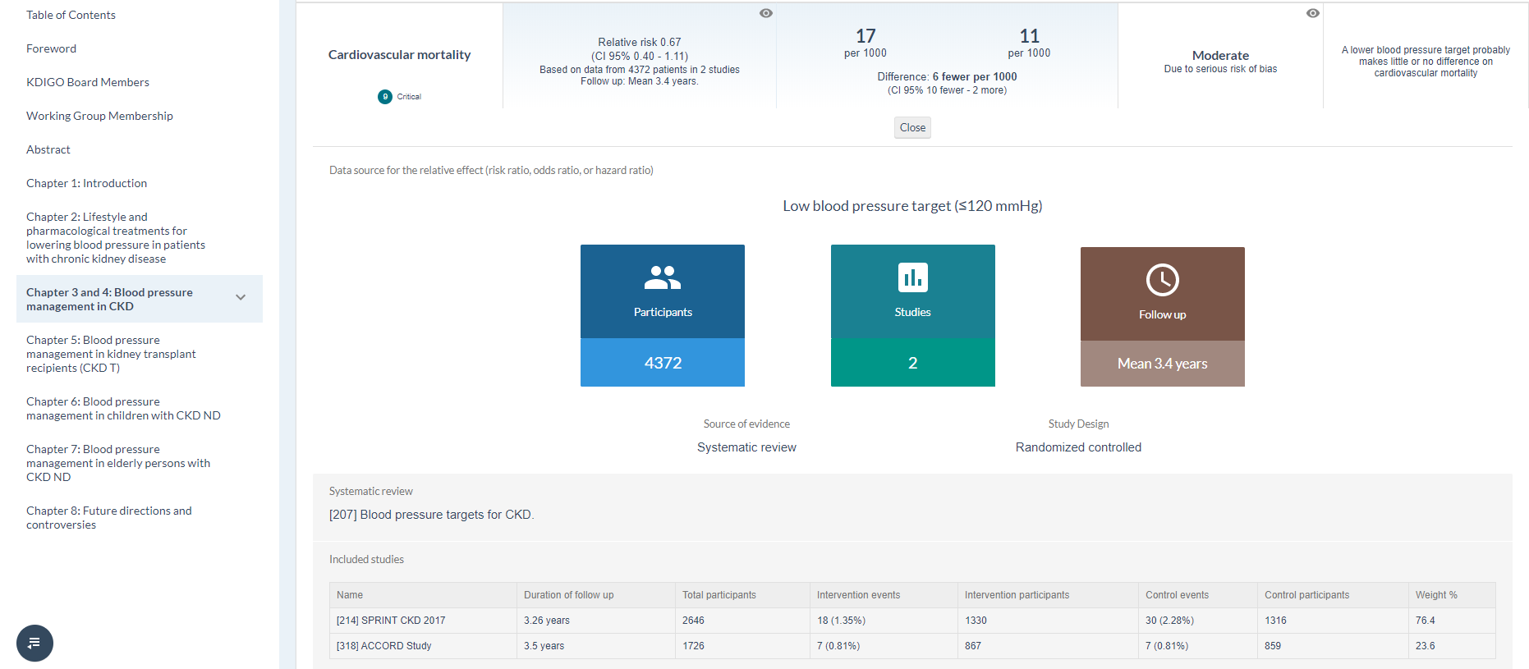
MAGICapp – Evidence to Recommendation
Studies and references linked directly to tables
Ease of updating – new studies added to existing evidence

Slide 27
Blood Pressure in CKD Guideline Contents
Chapter 1. Blood pressure measurement
Chapter 2. Lifestyle interventions for lowering blood pressure in patients with CKD not receiving dialysis
Sodium intake
Physical activity
Chapter 3. Blood pressure management in patients with CKD, with or without diabetes, not receiving dialysis
Blood pressure targets
Treatment with antihypertensive drugs, including RAS inhibitors (RASi)
Role of dual therapy with RASi
Chapter 4. Blood pressure management in kidney transplant recipients (CKD G1T-G5T)
Chapter 5. Blood pressure management in children with CKD

Slide 28
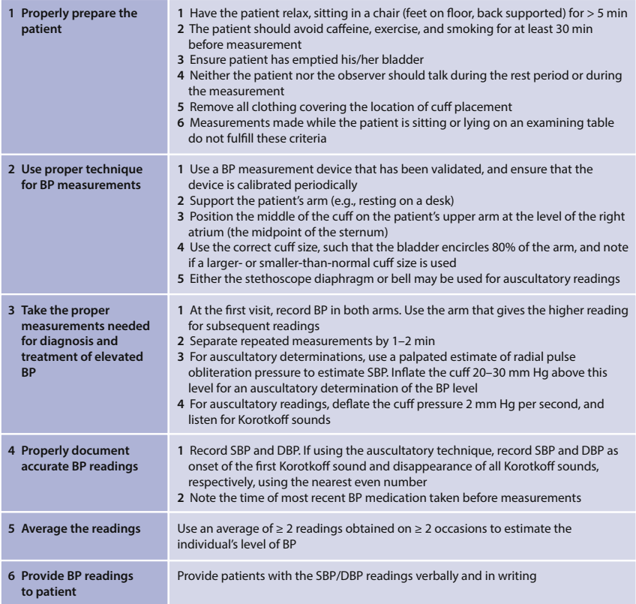
Blood Pressure Measurement
Recommendation 1.1. We recommend standardized office BP measurement in preference to routine office BP measurement for the management of high BP in adults (1B).

Slide 29
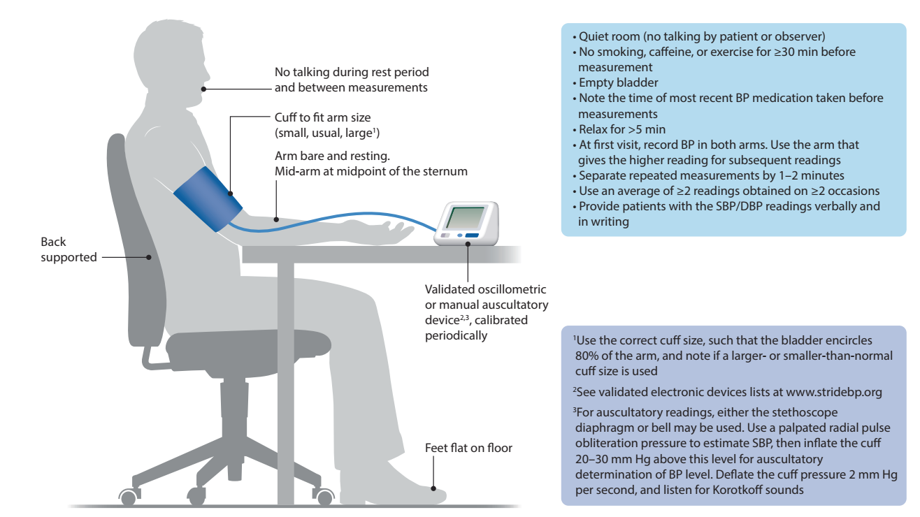
Blood Pressure Measurement

Slide 30
Standardized BP Measurement
Key is proper preparations
Abstinence from caffeine, exercise and smoking for >30 min
Feet on floor; arm and back supported
Keep quiet (and not talked to) and relaxed for >5 min
Use validated equipment
Correct cuff size and position
Advantages
Employed in large RCTs (e.g., ACCORD and SPRINT)
Minimizes misclassification and over-treatment or under-treatment of high BP
Disadvantages
Requires staff training and retraining
Requires more time of patients, providers and staff

Slide 31
Blood Pressure Measurement
Practice Point 1.1: An oscillometric BP device may be preferable to a manual BP device for standardized office BP measurement; however, standardization emphasizes adequate preparations for BP measurement, not the type of equipment.
Practice Point 1.2: Automated office BP (AOBP), either attended or unattended, may be the preferred method of standardized office BP measurement.
Practice Point 1.3: Oscillometric devices can be used to measure BP among patients with atrial fibrillation.
May increase likelihood of adherence to proper BP measurement protocols
Removes potential sources of inaccuracies with manual measurement
May reduce white-coat effect
Frees staff to complete other duties
Used in prior RCTs and prospective cohort studies
But, probably not as important as proper preparations

Slide 32
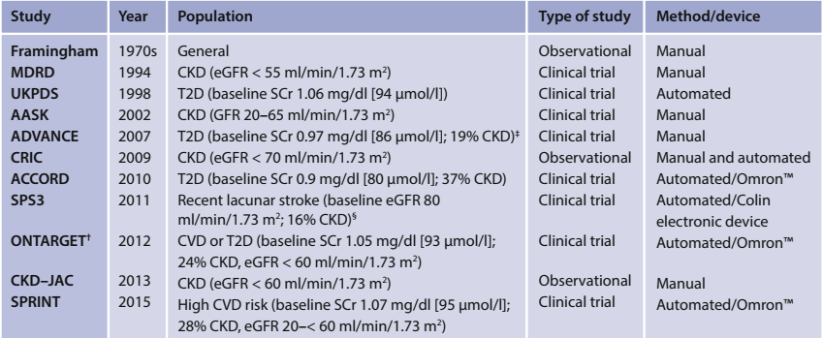
Blood Pressure Measurement Method and Device Used in Select RCTs and Prospective Observational Studies

Slide 33
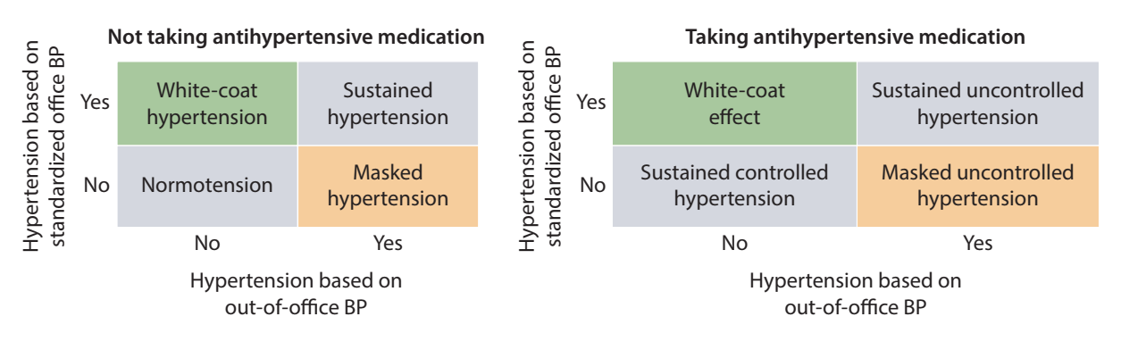
Blood Pressure Measurement
Recommendation 1.2: We suggest that out-of-office BP measurements with ambulatory BP monitoring (ABPM) or home BP monitoring (HBPM) be used to complement standardized office BP readings for the management of high BP (2B).

Slide 34
Lifestyle Interventions for Lowering BP in Patients with CKD not Receiving Dialysis
Recommendation 2.1.1: We suggest targeting a sodium intake <2 g of sodium per day (or <90 mmol of sodium per day, or <5 g of sodium chloride per day) in patients with high BP and CKD (2C).
Practice Point 2.1.1: Dietary sodium restriction is usually not appropriate for patients with sodium-wasting nephropathy.
Practice Point 2.1.2: The Dietary Approaches to Stop Hypertension (DASH)-type diet or use of salt substitutes that are rich in potassium may not be appropriate for patients with advanced CKD or those with hyporeninemic hypoaldosteronism or other causes of impaired potassium excretion because of the potential for hyperkalemia.

Slide 35
Lifestyle Interventions for Lowering BP in Patients with CKD not Receiving Dialysis
Recommendation 2.2.1: We suggest that patients with high BP and CKD be advised to undertake moderate-intensity physical activity for a cumulative duration of at least 150 minutes per week, or to a level compatible with their cardiovascular and physical tolerance (2C).
Practice Point 2.2.1: Consider the cardiorespiratory fitness status, physical limitations, cognitive function, and risk of falls when deciding on the implementation and intensity of physical activity interventions in individual patients.
Practice Point 2.2.2: The form and intensity of physical activity should be considered and modified as necessary in individual patients. There may still be important health benefits even if physical activity falls below targets proposed for the general population.

Slide 36
Blood Pressure Management in Patients with CKD, with or without Diabetes, not Receiving Dialysis
Recommendation 3.1.1: We suggest that adults with high BP and CKD be treated with a target systolic blood pressure (SBP) of <120 mm Hg, using standardized office BP measurement (2B).
This recommendation is weak according to GRADE because there is less certainty that the benefits outweigh the harms in the following scenarios:
CKD G4 and G5
Diabetes
Individuals with SBP 120-129 mm Hg
Patients with very low baseline diastolic BP, particularly in the presence of coronary artery disease
Specific etiology of CKD
Severely increased proteinuria
Older age
Younger age
Very frail
“White coat” hypertension
Severe hypertension
Individualization is KEY

Slide 37
Rationale for Target SBP <120 mm Hg in CKD
For most patients with CKD, a cardiovascular event is a more likely outcome than ESKD.¹
SPRINT confirmed cardiovascular and survival benefits in non-diabetic CKD.²
ACCORD showed marked reduction in stroke in diabetes, but only included 401 patients with eGFR <60 ml/min/1.73m²; nonetheless, benefits of SBP <120 mm Hg in the standard glycemia arm similar to those seen in SPRINT.^{3,4}
Meta-analyses demonstrate reduction of CV risk proportional to BP lowering, though some show lower proportional risk reduction in the presence of CKD and of DM.^{5,6,7}
¹O’Hare J Am Soc Nephrol 2007;18: 2758. ²Cheung JASN 2017; 28: 2812. ³Papademetriou Am J Nephrol 2016; 43: 271. ⁴Tsuijimoto Hypertension 2018;72;323. ⁵BPLTC BMJ 2013;347:f5680; ⁶Ettehad Lancet 2016;387:435; ⁷Malhotra JAMA Int Med 2017;177:1498

Slide 38
Low BP Target (<120 mm Hg) vs. Standard BP Target (<140 mm Hg)
Outcome Timeframe | Study results and measurements | Absolute effect estimates |  | Certainty of evidence (Quality of evidence) | Plain text summary
 |  | Standard BP target (<140 mm Hg) | Low BP target (<120 mm Hg)
All-cause mortality (Mean follow-up 3.4 years) | Relative risk: 0.75 (95% CI 0.57 – 0.99) Based on data from 4372 patients and 2 studies* | 53 per 1000 | 40 per 1000 | Moderate (Due to serious risk of bias) | A lower BP target probably decreased all-cause mortality
 |  | Difference: 13 fewer per 1000 (95% CI 23 fewer – 1 fewer)
Cardiovascular mortality (Mean follow-up 3.4 years) | Relative risk: 0.67 (95% CI 0.40 – 1.11) Based on data from 4372 patients and 2 studies* | 17 per 1000 | 11 per 1000 | Moderate (Due to serious risk of bias) | A lower BP target probably makes little or no difference on cardiovascular mortality
 |  | Difference: 6 fewer per 1000 (95% CI 10 fewer – 2 more)
End-stage kidney disease or >50% loss of GFR (Mean follow-up 3.26 years) | Relative risk: 0.93 (95% CI 0.46 – 1.87) Based on data from 2646 patients and 1 study† | 12 per 1000 | 11 per 1000 | Low (Due to serious risk of bias; Due to serious imprecision) | A lower BP target probably may have little or no effect on end-stage kidney disease or >50% loss of GFR
 |  | Difference: 1 fewer per 1000 (95% CI 6 fewer – 10 more)
Acute kidney injury (Mean follow-up 3.26 years) | Relative risk: 1.45 (95% CI 1.10 – 1.91) Based on data from 2646 patients and 1 study† | 33 per 1000 | 48 per 1000 | Low (Due to serious risk of bias; Due to serious imprecision) | A lower BP target may increase acute kidney injury
 |  | Difference: 15 more per 1000 (95% CI 3 more – 30 more)
*Cheung AK, Rahman M, Reboussin DM, et al. Effects of Intensive BP Control in CKD. Journal of the American Society of Nephrology. 2017;28(9):2812-2823; Cushman WC, Evans GW, Byington RP, et al. Effects of intensive blood-pressure control in type 2 diabetes mellitus. The New England Journal of Medicine. 2010;362(17):1575-1585
†Cheung AK, Rahman M, Reboussin DM, et al. Effects of Intensive BP Control in CKD. Journal of the American Society of Nephrology. 2017;28(9):2812-2823

Slide 39
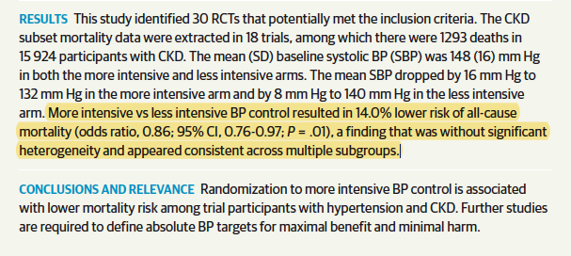
Meta-Analysis of Trials of Intensive vs. Less-Intensive BP Lowering in CKD on Mortality Outcome
Malhotra R. JAMA Int Med 2017: 177: 1-8

Slide 40
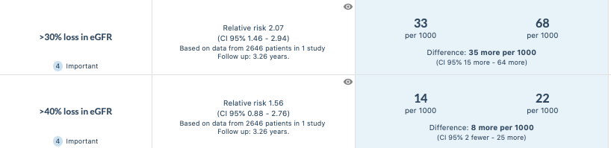
Risk of CKD Progression with Intensive BP Lowering Therapy
Intensive BP control causes initial drop in GFR, without increase in tubular injury markers, and with reduction in albuminuria – probably due to altered intrarenal hemodynamics.
However, overall rate of decline in eGFR was higher with intensive BP control in SPRINT (in both CKD and non-CKD cohorts), ACCORD, and SPS.
Difference in rate of decline after initial 6 months in SPRINT: 0.47 vs. 0.32 ml/min/1.73 m²/year in intensive vs. standard: if sustained over 20 y, this would cause only a 3 ml/min difference.

Slide 41
Blood Pressure Management in Patients with CKD, with or without Diabetes, not Receiving Dialysis
Practice Point 3.1.1: It is potentially hazardous to apply the recommended SBP target of <120 mm Hg to BP measurements obtained in a non-standardized manner.
Practice Point 3.1.2: Clinicians can reasonably offer less intensive BP-lowering therapy in patients with very limited life expectancy or symptomatic postural hypotension.

Slide 42
Challenges for Implementation of SBP Target
SBP <120 mm Hg conflicts with some, but not all national and international guidelines
Resource implications
Standardized office BP measurement (supplemented by ABPM or HBPM)
Costs of intensive BP control
Direct costs of drug therapy
Indirect costs – e.g. electrolyte monitoring

Slide 43
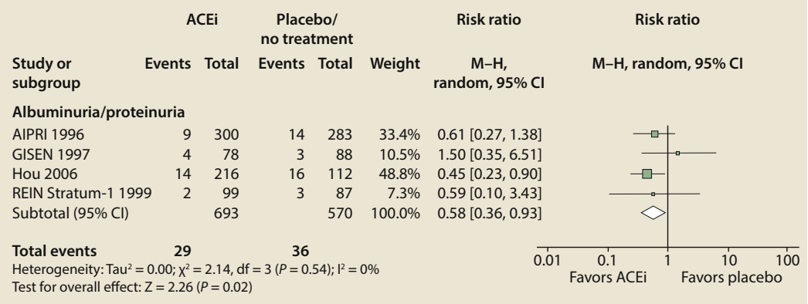
Blood Pressure Management in Patients with CKD, with or without Diabetes, not Receiving Dialysis
Recommendation 3.2.1: We recommend starting renin-angiotensin-system inhibitors (RASi) (angiotensin-converting enzyme inhibitor [ACEi] or angiotensin II receptor blocker [ARB]) for people with high BP, CKD, and severely increased albuminuria (G1-G4, A3) without diabetes (1B).
Cardiovascular events in patients with CKD G3-G4, A3 without diabetes

Slide 44
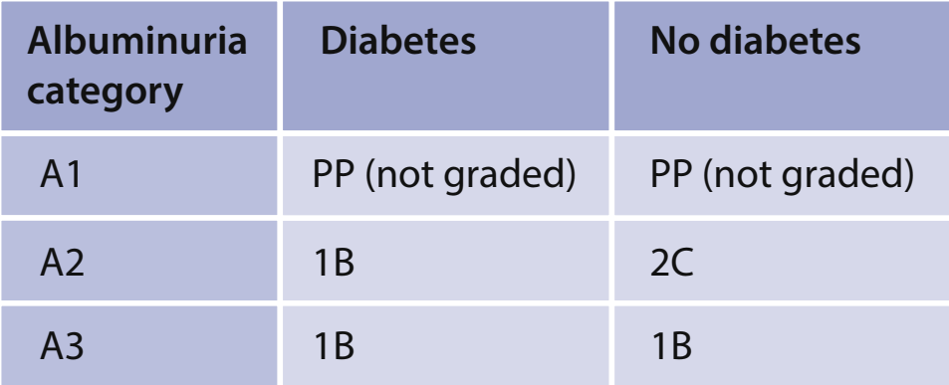
Blood Pressure Management in Patients with CKD, with or without Diabetes, not Receiving Dialysis
Recommendation 3.2.2: We suggest starting RASi (ACEi or ARB) for people with high BP, CKD, and moderately increased albuminuria (G1-G4, A2) without diabetes (2C).
Recommendation 3.2.3: We recommend starting RASi (ACEi or ARB) for people with high BP, CKD, and moderately-to-severely increased albuminuria (G1 to G4, A2 and A3) with diabetes (1B).

Slide 45
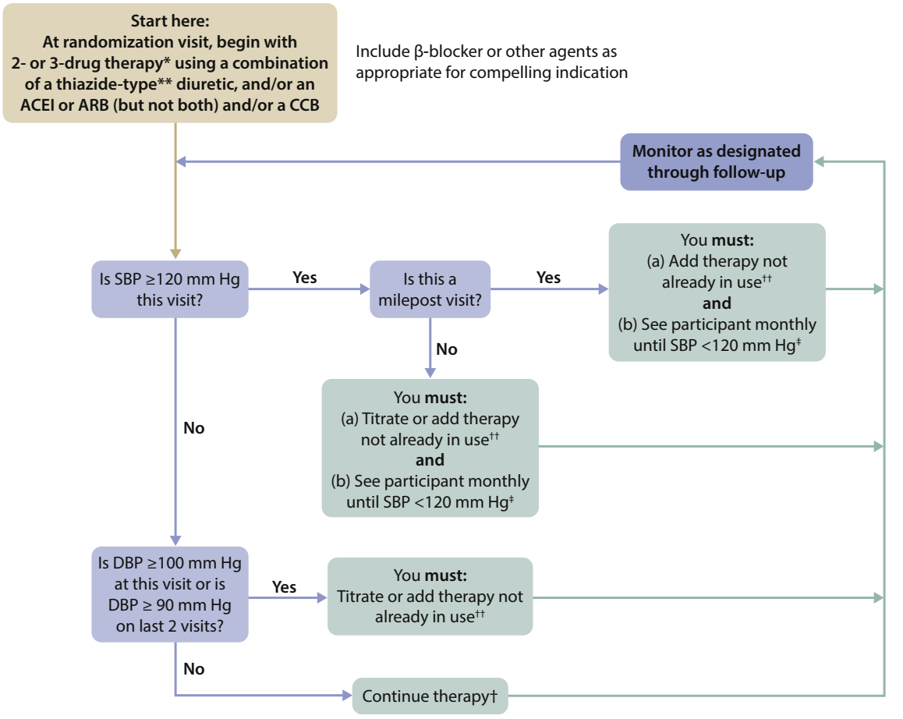
Blood Pressure Management in Patients with CKD, with or without Diabetes, not Receiving Dialysis
SPRINT protocol

Slide 46
Blood Pressure Management in Patients with CKD, with or without Diabetes, not Receiving Dialysis
Practice Point 3.2.1: It may be reasonable to treat people with high BP, CKD, and no albuminuria, with or without diabetes, with RASi (ACEi or ARB).
Practice Point 3.2.2: RASi (ACEi or ARB) should be administered using the highest approved dose that is tolerated to achieve the benefits described because the proven benefits were achieved in trials using these doses.
Practice Point 3.2.3: Changes in BP, serum creatinine, and serum potassium should be checked within 2-4 weeks of initiation or increase in the dose of a RASi, depending on the current GFR and serum potassium.
Practice Point 3.2.4: Hyperkalemia associated with use of RASi can often be managed by measures to reduce the serum potassium levels rather than decreasing the dose or stopping RASi.

Slide 47
Blood Pressure Management in Patients with CKD, with or without Diabetes, not Receiving Dialysis
Practice Point 3.2.5: Continue ACEi or ARB therapy unless serum creatinine rises by more than 30% within 4 weeks following initiation of treatment or an increase in dose.
Practice Point 3.2.6: Consider reducing the dose or discontinuing ACEi or ARB in the setting of either symptomatic hypotension or uncontrolled hyperkalemia despite medical treatment, or to reduce uremic symptoms while treating kidney failure (estimated glomerular filtration rate [eGFR] <15 ml/min per 1.73 m²).
Practice Point 3.2.7: Mineralocorticoid receptor antagonists are effective for management of refractory hypertension but may cause hyperkalemia or a reversible decline in kidney function, particularly among patients with low eGFR.

Slide 48
Blood Pressure Management in Patients with CKD, with or without Diabetes, not Receiving Dialysis
Recommendation 3.3.1: We recommend avoiding any combination of ACEi, ARB, and direct renin inhibitor (DRI) therapy in patients with CKD, with or without diabetes (1B).

Slide 49
Blood Pressure Management in Kidney Transplant Recipients (CKD G1T-G5T)
Practice Point 4.1. Treat adult kidney transplant recipients with high BP to a target BP of <130 mm Hg systolic and <80 mm Hg diastolic using standardized office BP measurement (see Recommendation 1.1.).
Recommendation 4.1. We recommend that a dihydropyridine calcium channel blocker (CCB) or an ARB be used as the first-line antihypertensive agent in adult kidney transplant recipients (1C).

Slide 50
Rationale for Target Practice Point in Kidney Transplant
No informative RCT evidence for optimal BP target in Kidney Transplant Recipients (KTRs).
KTRs value graft survival highly, and many would value death with a functioning graft more highly than return to dialysis.¹
Intensive BP control associated with a higher (albeit slightly) rate of loss of GFR over time in SPRINT and a higher risk of “AKI” (single, denervated kidneys may be at higher risk).
¹Tong A. Transplantation 2017; 101: 1887-1896

Slide 51
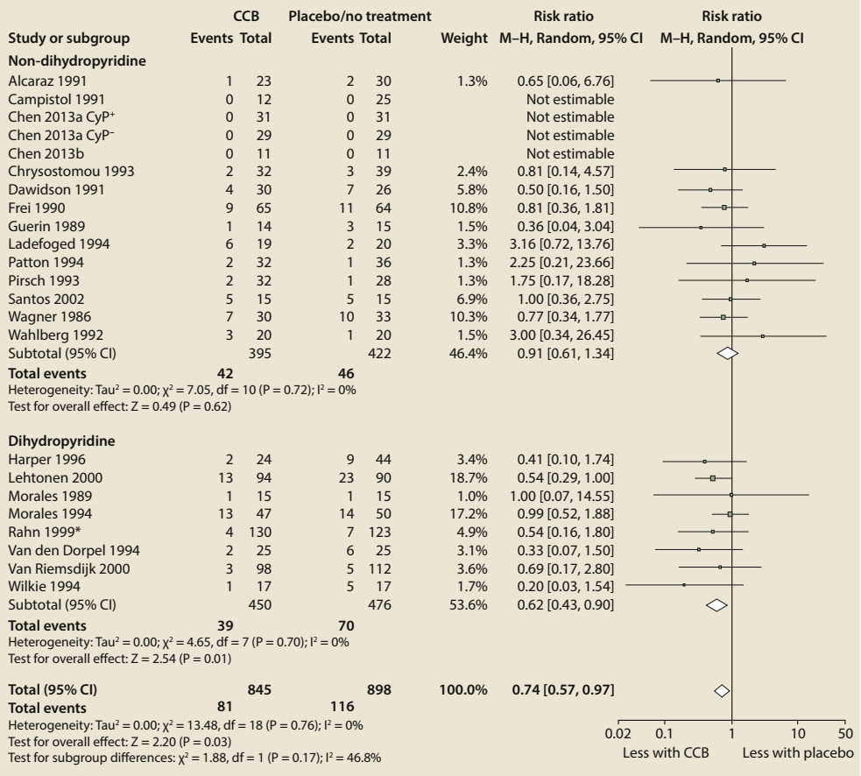
CCB vs. Placebo/No Treatment for the Outcome of Graft Loss
Non-dihydropyridine
Dihydropyridine

Slide 52
Blood Pressure Management in Children with CKD
Recommendation 5.1: We suggest that in children with CKD, 24-hour mean arterial pressure (MAP) by ABPM should be lowered to ≤50th percentile for age, sex, and height (2C).
Practice Point 5.1: We suggest monitoring BP once a year with ABPM, and monitoring every 3–6 months with standardized auscultatory office BP in children with CKD.
Practice Point 5.2: In children with high BP and CKD, when ABPM is not available, manual auscultatory office BP obtained in a protocol-driven standardized setting targeting achieved SBP <90th percentile for age, sex, and height of normal children is a reasonable approach.
Practice Point 5.3: Use ACEi or ARB as first-line therapy for high BP in children with CKD. These drugs lower proteinuria and are usually well tolerated, but they carry the risk of hyperkalemia and have adverse fetal risks for pregnant women.

Slide 53
Rationale for BP Target Recommendation in Children
Rests heavily on ESCAPE trial:
Probable benefit in slowing CKD progression, and reducing left ventricular hypertrophy, with no increased risk of adverse events.
Children with proteinuria may benefit more; risks may be higher in those with salt-wasting disease.
Escape Trial Study Group. NEJM 2009: 361: 1639-1650

Slide 54
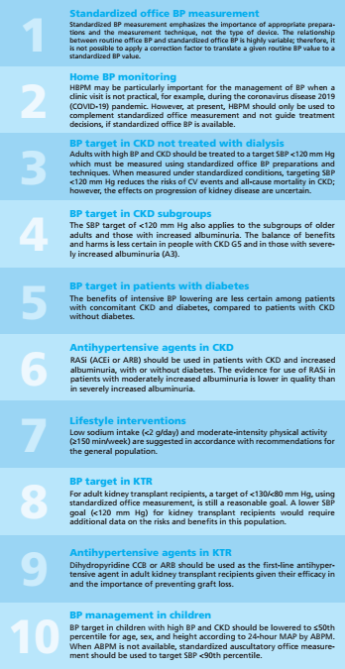
Top 10 Key Takeaways for Clinicians

Slide 55
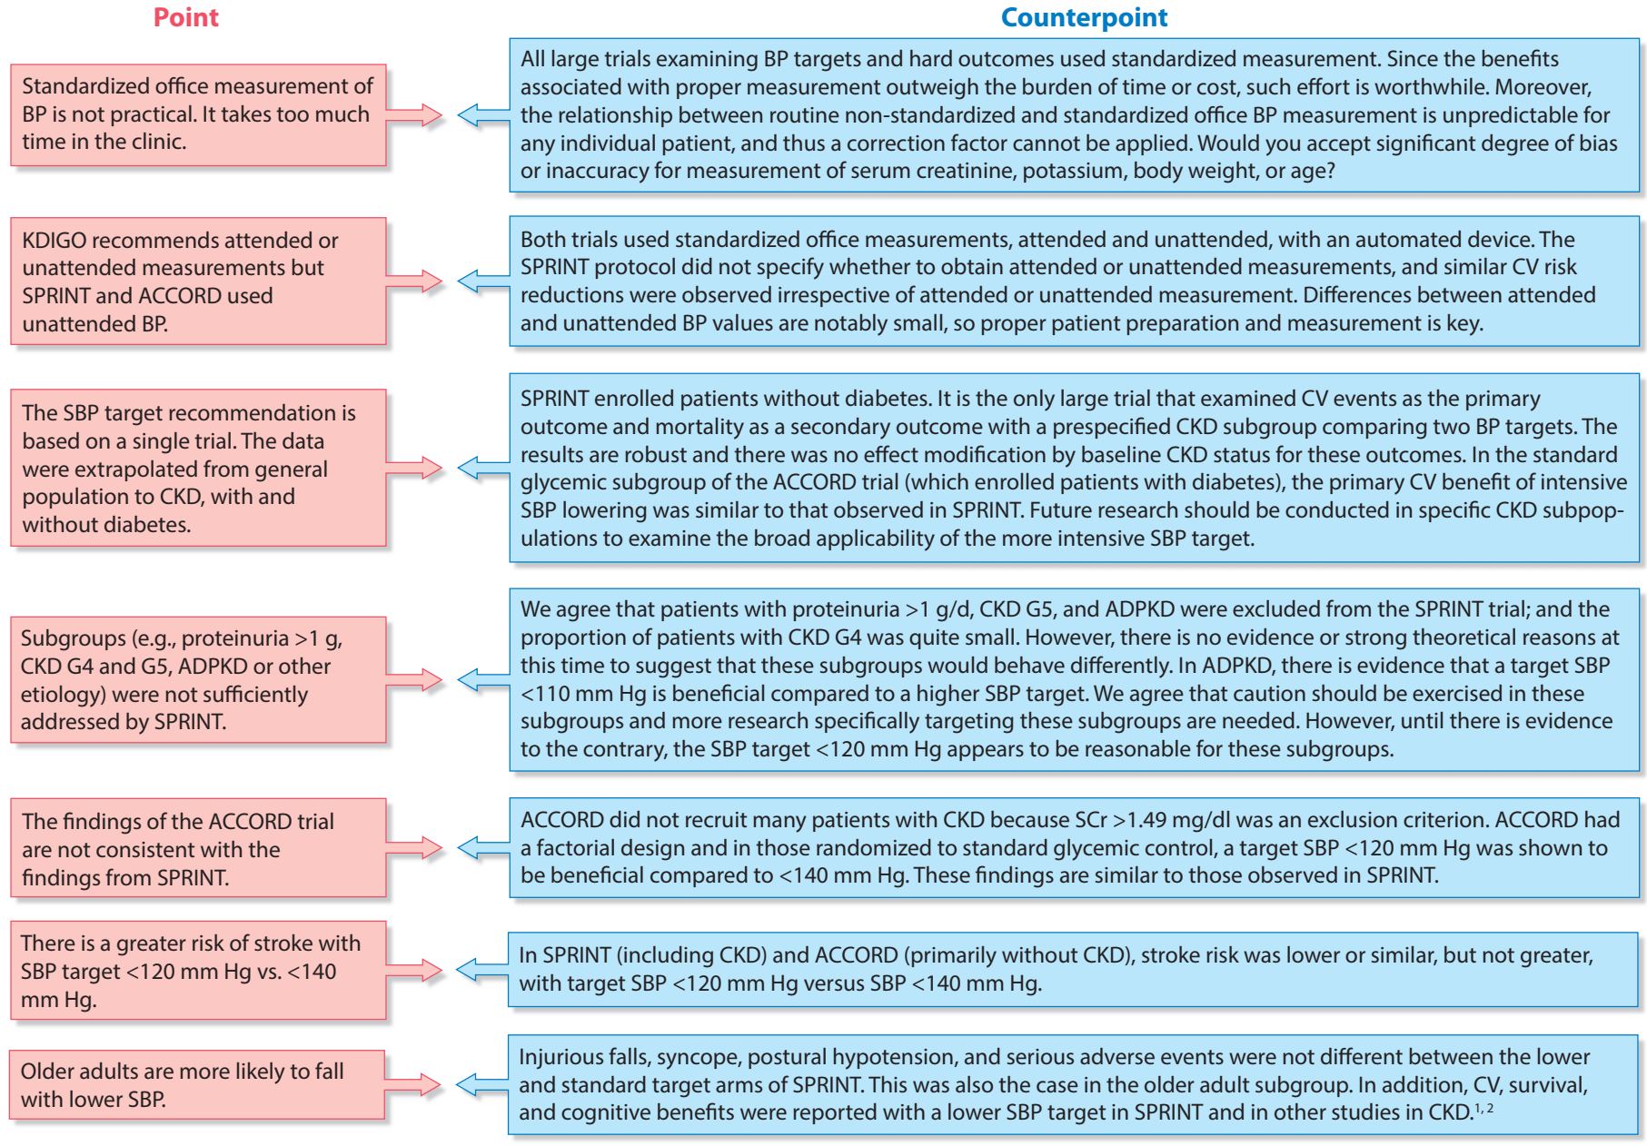
Main Points of Controversy

Slide 56
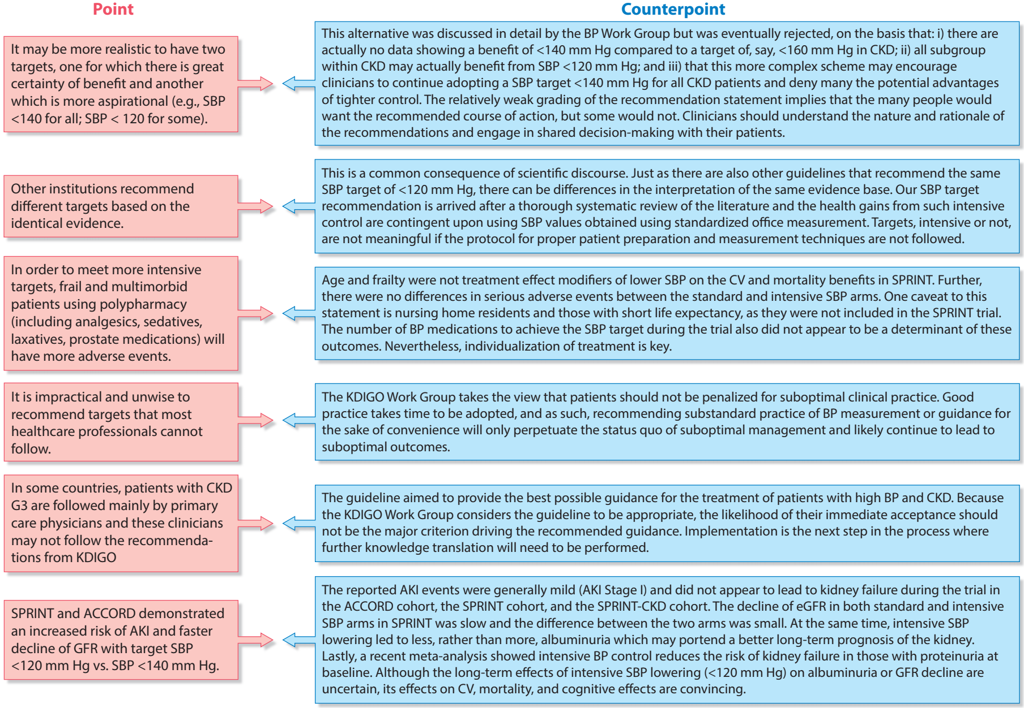
Main Points of Controversy

Slide 57
Overall Summary
Update to 2012 KDIGO guideline on BP Management in CKD
Provide recommendations and practice points on:
BP measurement
Lifestyle interventions for lowering BP in patients with CKD not receiving dialysis
BP management in patients with CKD, with or without diabetes, not receiving dialysis; in kidney transplant recipients (CKD G1T-G5T); and in children in CKD
Standardized blood pressure measurement is consistent with large clinical trials with clinically important outcomes that used this measurement technique to define BP targets.
CKD patients with high BP should limit their salt intake and undertake moderate intensity physical activity.
CKD patients with high BP should be treated to a SBP target of <120 mm Hg using standardized office BP measurement. Individualization is KEY!
RASi (ACEi or ARB) should be used in patients with CKD and increased albuminuria, with or without diabetes. the recommendation and evidence in those with severely increased albuminuria and in diabetic patients with moderately increased albuminuria are particularly strong.
Kidney transplant recipients should be treated to a target of <130/<80 using standardized office BP measurement.
Children with CKD should be treated to lower 24h MAP by ABPM to ≤50th percentile for age, sex, and height.

Slide 58
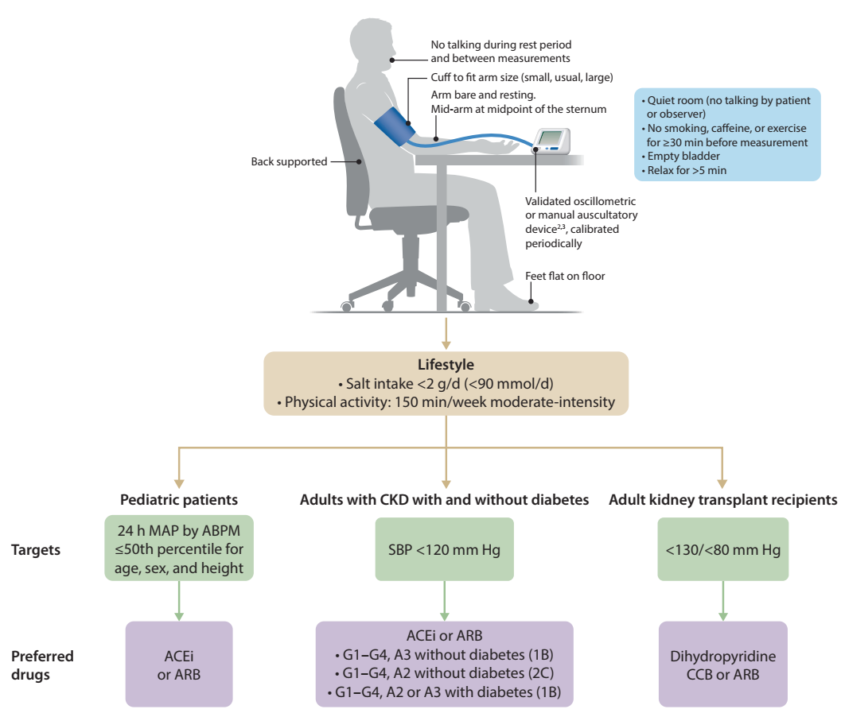
Central Illustration

Slide 59
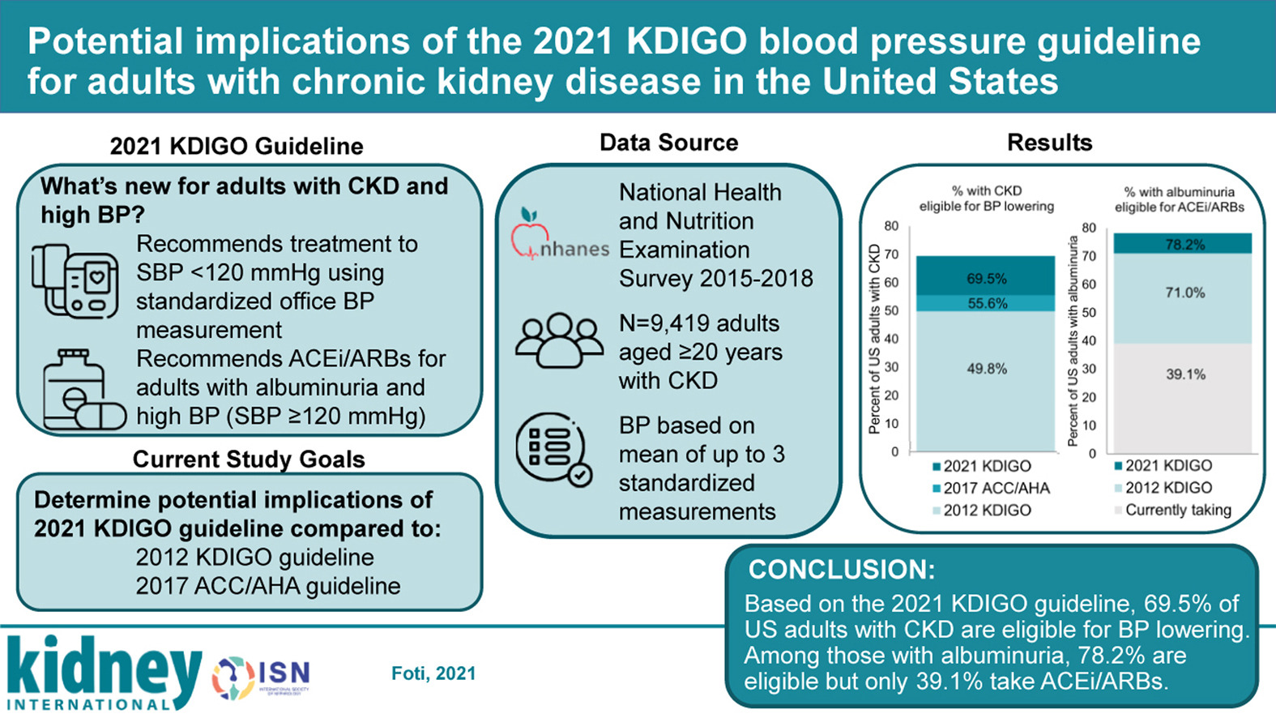
Potential Implications
Kidney International 2021 99686-695DOI: (10.1016/j.kint.2020.12.019)

Slide 60
Question and Answer

